Slide 1
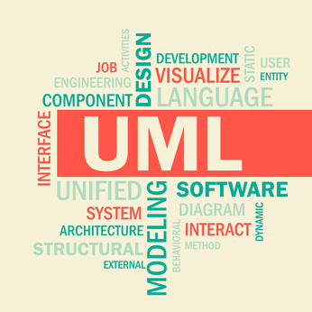
UML, RUP etc.
Marcin Skurczyński
Introduction to Programming for Business

Slide 2
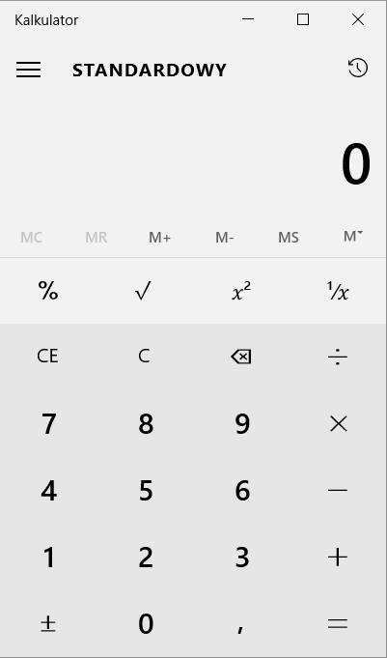
How to describe this software??

Slide 3


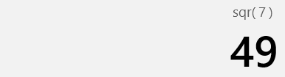
Approach 1: Reengineering
„I wonder what happens if I press that…”
Pressing:
Then:
Effect:

Slide 4
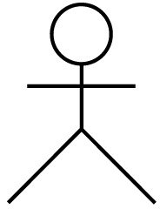
Approach 2: Use cases
How will I be using that tool?

Slide 5
Process of software development?
How do you manage your projects (any)?

Slide 6
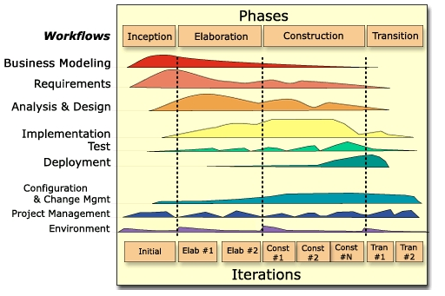
RUP: Rational Unified Process
http://uranus.wat.edu.pl:8808/wiki/images/c/c3/Rup_fundamentals.jpg

Slide 7
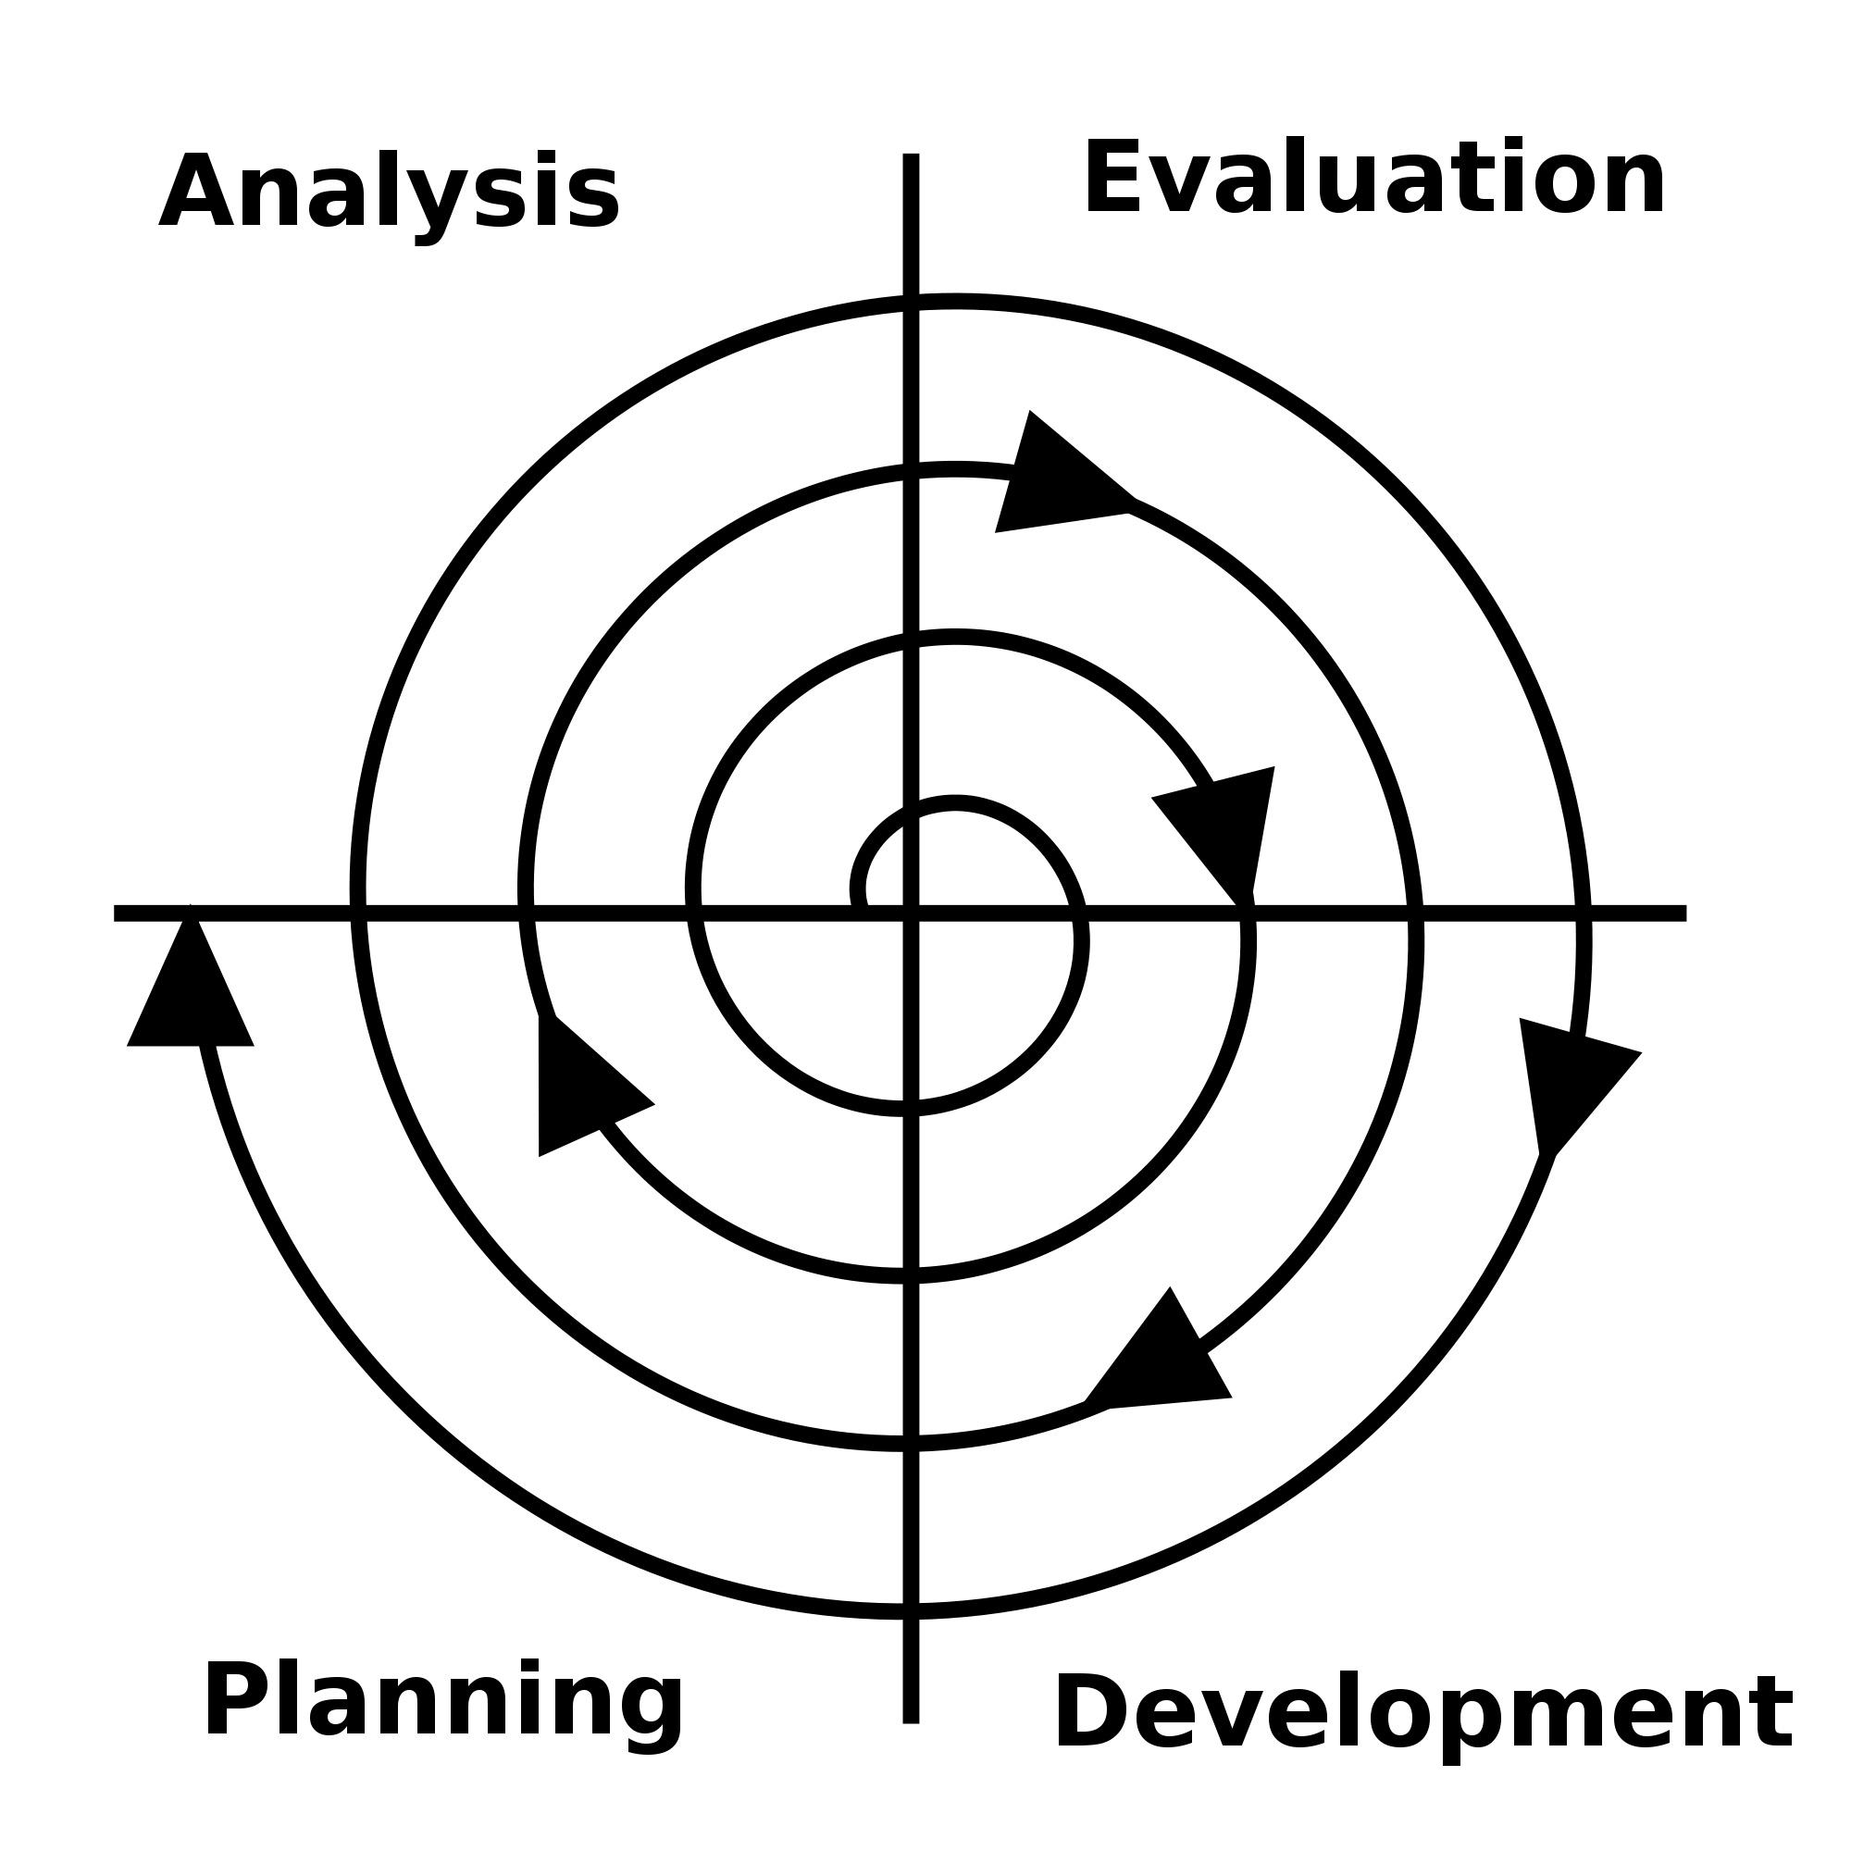
Spiral Model (agile)
https://upload.wikimedia.org/wikipedia/commons/thumb/3/37/Software_Development_Spiral.svg/2000px-Software_Development_Spiral.svg.png

Slide 8
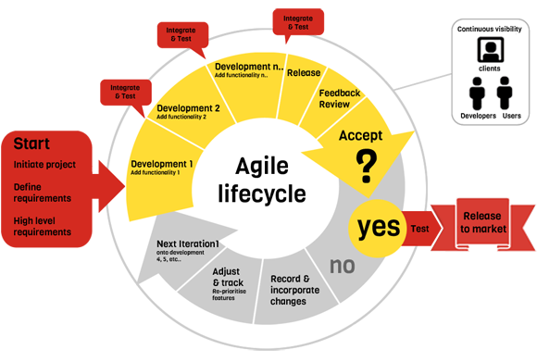
Agile project management
http://www.trugeek.in/wp-content/uploads/2016/12/agile-method1.png

Slide 9
Requirement definition
What is requirement? (IEEE 610 standard):
A condition or capability needed by a user to solve a problem or achieve an objective that must be met or possessed by a system or system component to satisfy a contract, standard, specification, or other formally imposed document.
http://testerzy.pl/slownik/wymaganie

Slide 10
Requirement engineering
A need
Business problem
Solution

Slide 11
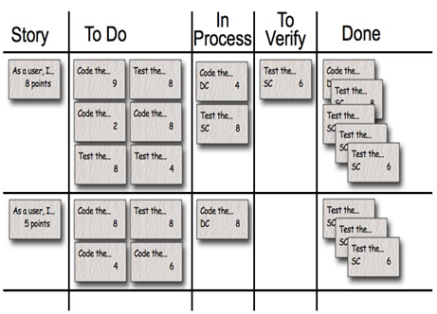
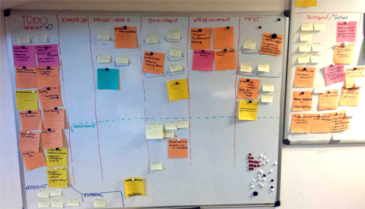
Agile, Scrum, Extreme…
https://www.michalwolski.pl/wp-content/uploads/2009/06/image10.png
http://www.e-point.pl/_fileserver/item/1500803/tablica.png?timestamp=1398853217122

Slide 12
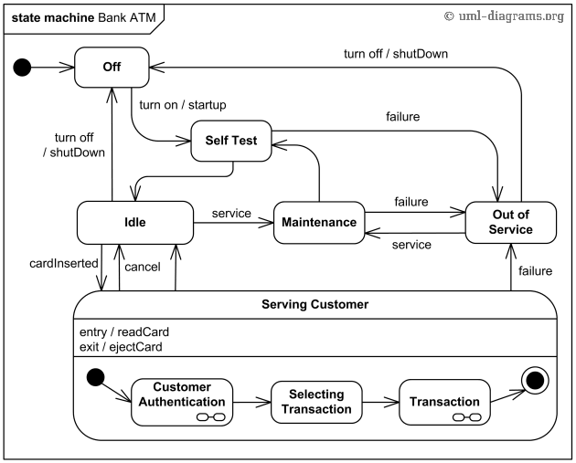
UML v. Requirements

Slide 13
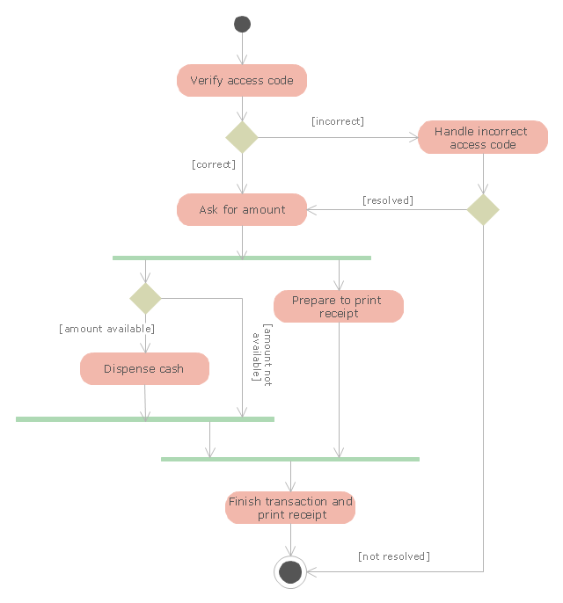
https://conceptdraw.com/a612c3/p1/preview/640/pict--uml-activity-diagram-uml-activity-diagram---cash-withdrawal-from-atm.png--diagram-flowchart-example.png

Slide 14
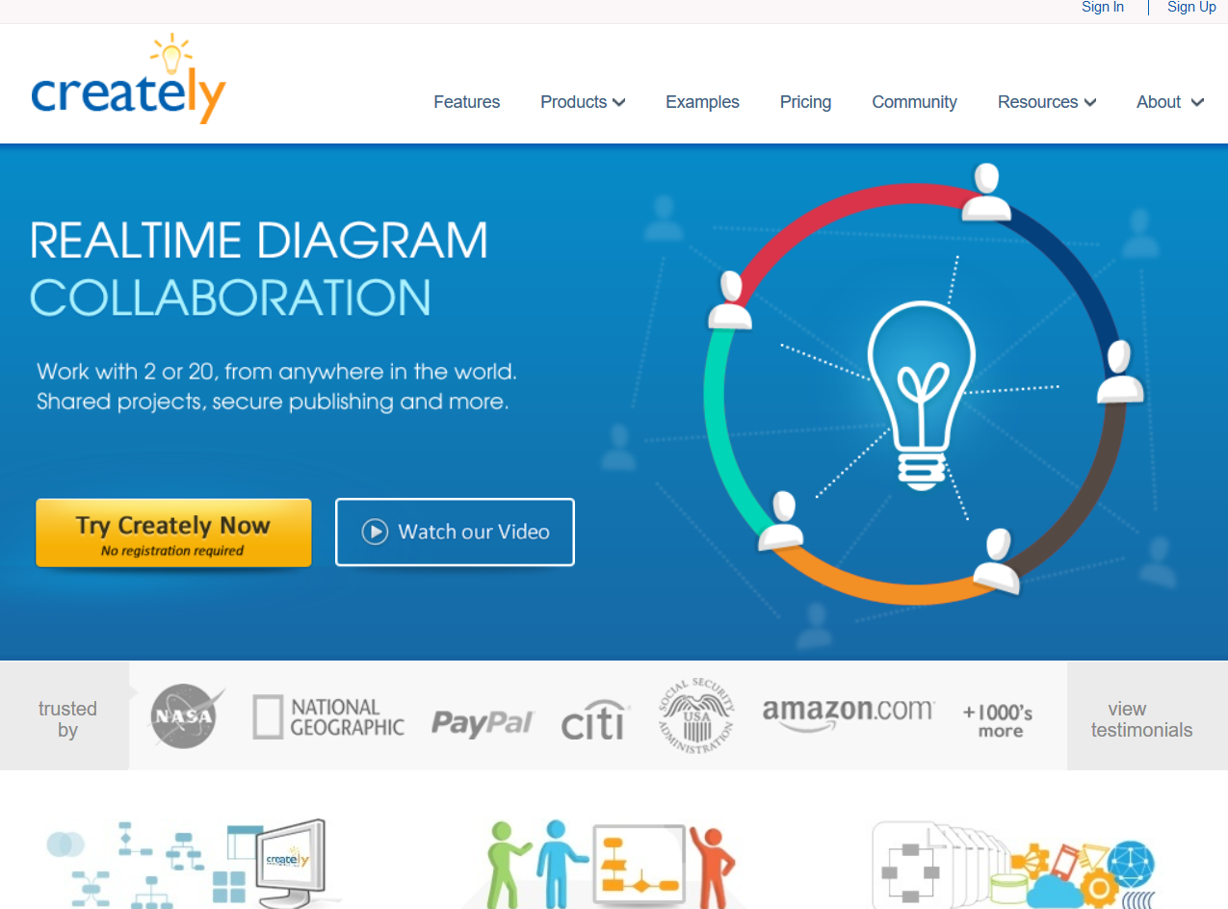
Task #3
visit http://creately.com/

Slide 15
Praca domowa
Prepare:
Use case diagram
Process diagram

